Slide 1

Supervisor:
Sir Ramzan Malik
Automated Product Price Comparison Website
Group Members:
Momina Jannat (BITF18M008)
Eeman Ahmed (BITF18M015)
Ahmer Ashraf (BITF18M039)

Slide 2
Problem Statement
Most of the working people do not have time to do shopping for their home groceries.
As consumers, they have the right to choose which shop is offering the best price for a certain products that they are interested in. However, to check on price offered by each shop is time consuming
Due to limited time that they have, they are not able to compare the prices and end up buying certain product with higher price.

Slide 3


Motivation
One search engine for shopping uses a more dynamic approach in searching different products. This price comparison website for products will help to compare the products price from various e-commerce websites.
This system makes it convenient and easier for frequent online shoppers or customers to check prices of different items on different online stores in one place. The system shows you the product prices from different retailers and gives you multiple choices to purchase products/items in affordable prices.
It is time saving and make it easier to shop at reasonable and affordable price.

Slide 4
Achievement
Instead of taking hours and energy to go to each shops just want to check on the price, Dreamy Shop offered better solution by getting all the price.
Users just need to go online and choose which product they want to know and the list of retailers and the price offered will be shown.
Users can check it from anywhere, no matter at home or at work,
or even in the train while going back from work.
Dreamy Shop is accessible anytime as long as there is internet connection.

Slide 5
Achievement
Provides users with the most affordable pricing for the product.
It's easy, quick, offers plenty of information, and the buying process is a smooth one too.
Users save a lot of time because they don’t have to use various other sites.
Users form an opinion on the positive and negative elements of the thing they wish to buy.
Users look for the most suitable substitutes for the product.

Slide 6
Overview
Nowadays people usually conduct their first research on the internet regarding a particular product or service that they want which is very convenient as compared to what consumers had to do previously when there is no internet.
Back then, consumers have to go through books, magazines, newspapers, encyclopedias, and other mediums to find needed information. Everything has to be done manually and requires a lot of time, energy, and resources to find information without the help of the internet.
Comparison sites are known as the second type of search technology as it helps users find products and services according to what users have chosen. It helps consumers to easily compare the alternatives available on the market and reduce consumer search costs at the same time.

Slide 7
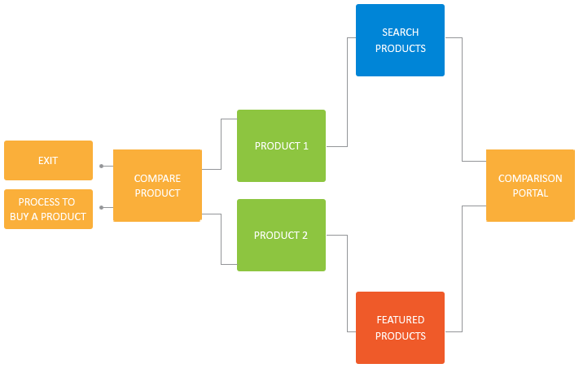
Methadology

Slide 8
Metodology
Manually adding data:
This is the suitable option as we are building a price comparison website with a few e-commerce websites.
We get data from vendors about their products and prices and we manually add data to the website and update every time the stock or price changes.
It is very easy to implement.

Slide 9
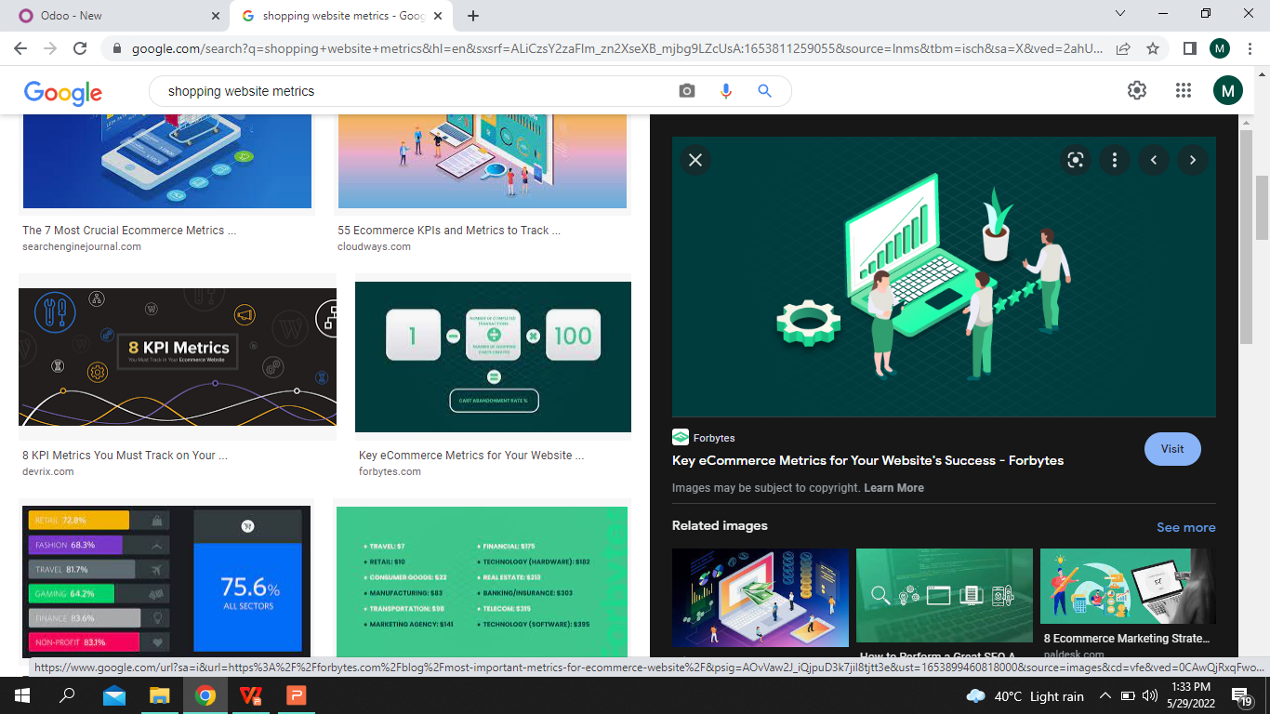
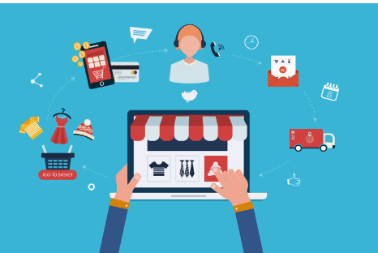
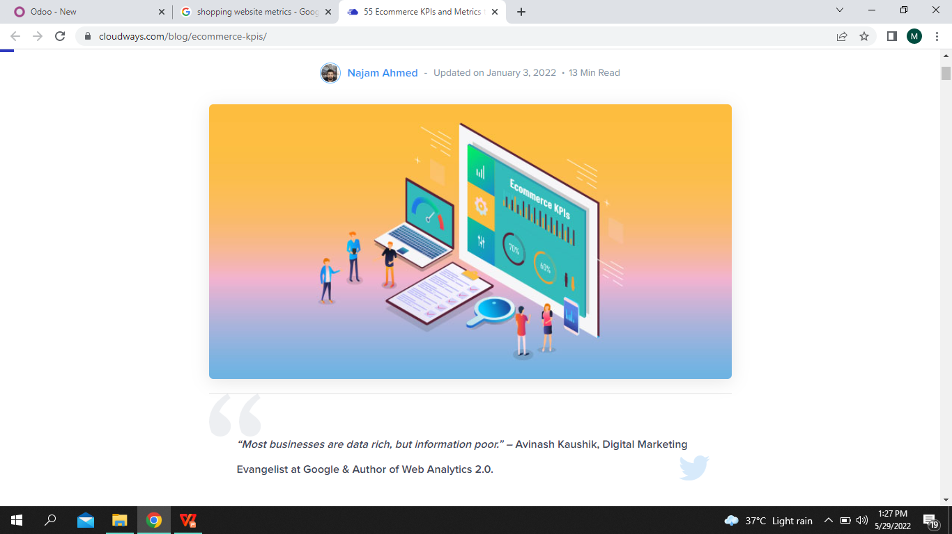
Metrics
Customer Lifetime Value
A
Invest in client retention
Offer client loyalty programs
Use social media marketing
Customer Acquisition Cost
B
Prioritize a particular segment.
Retarget your users.
Automate marketing effort.
Client Reviews
C
Average Order Value

Slide 10
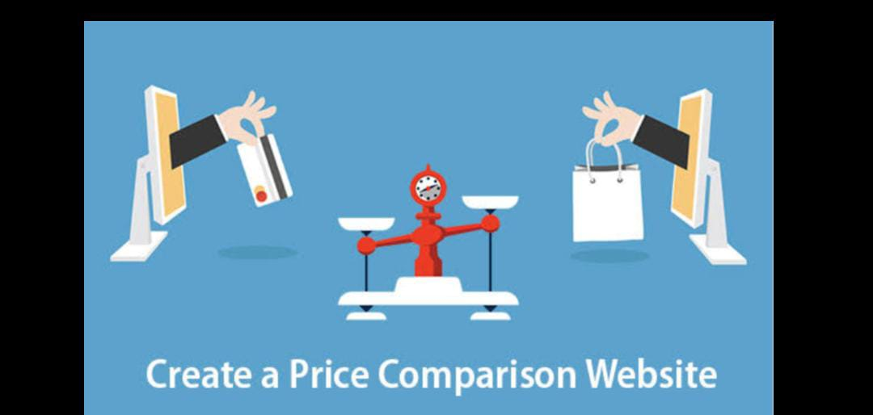
Results
When a buyer searches for a product on this price comparison website, the site compares and displays listings of the same product from multiple sellers. The buyer can then compare the listings based on price deals, features, shipping costs, etc to find the best deal.

Slide 11
Conclusion
A convenient and functional price comparison website saves shoppers time, stimulates sales for companies, and becomes an effective profit tool for those who own it.
Price comparison website development is a complicated task that requires a notable investment of money and time. Although, if you approach this process in the right way, you can create a successful product to get a good return on investment for your business.
You can easily and quickly find the best deal, and save yourself a good amount of money in the process.

